Slide 1


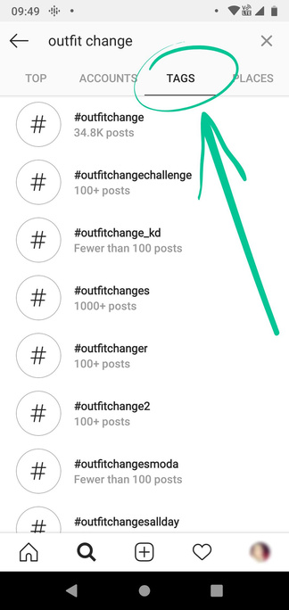
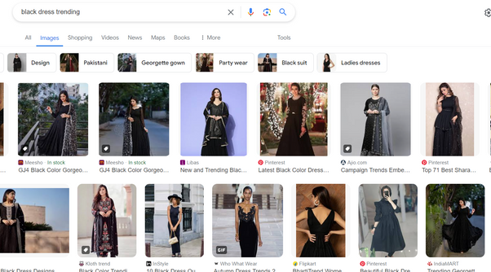
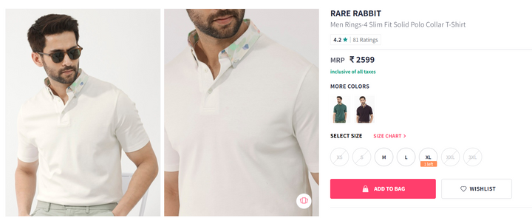
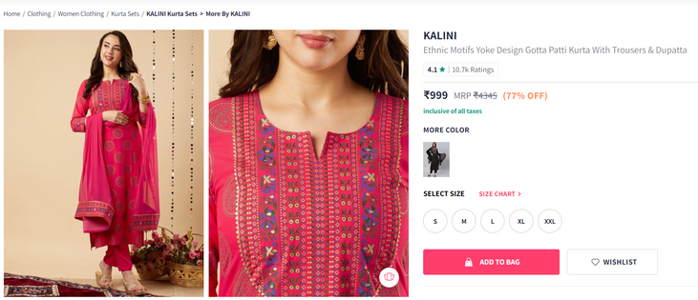
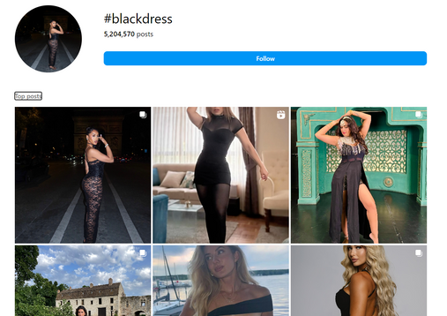
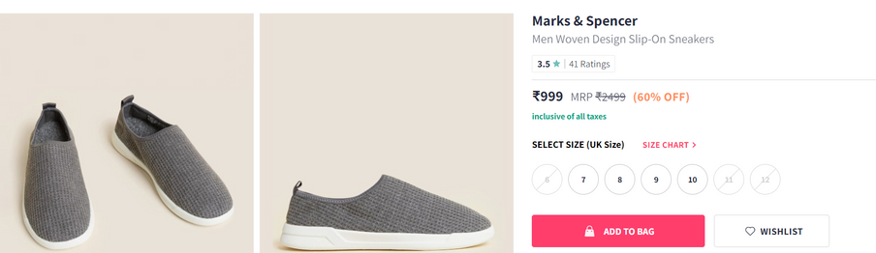
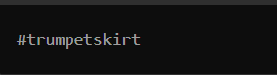
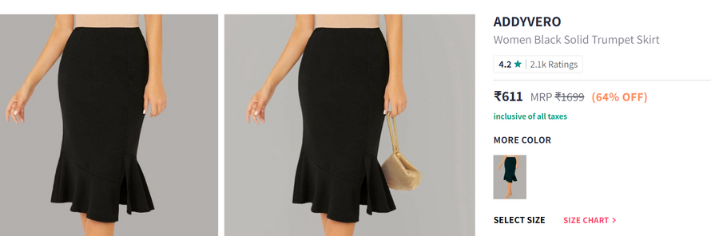
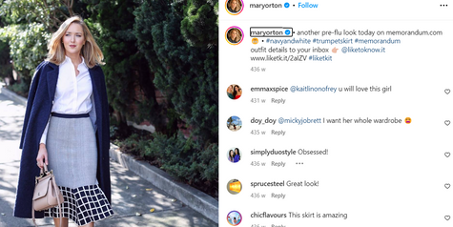
Trend Lens
Identify The Trends and Get Recommendation
Team Name: Hercode
Team details:
Members- Riya Kumari,Khushi Chaudhary
Topic-Trend Identification and Trend Centric Recommendations

Slide 2
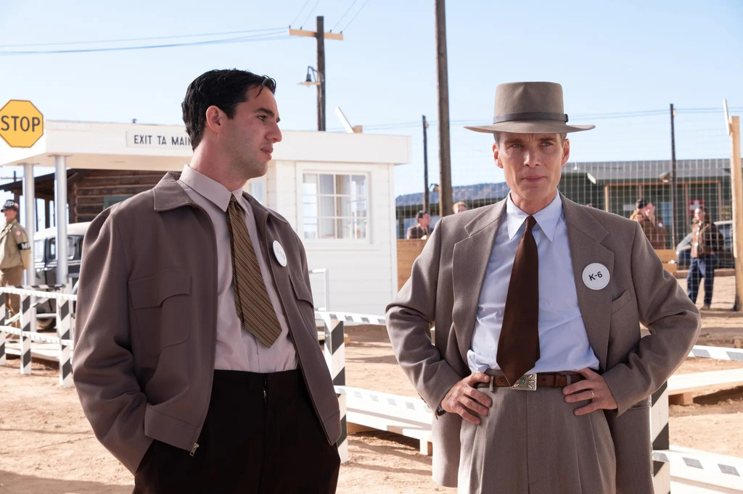
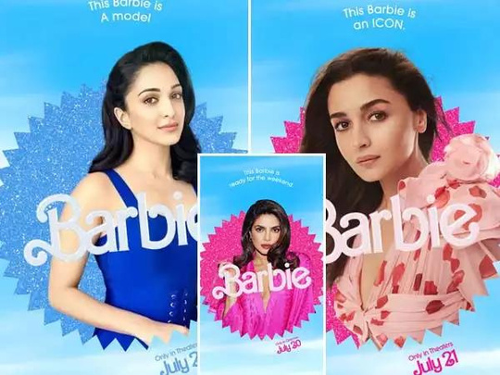
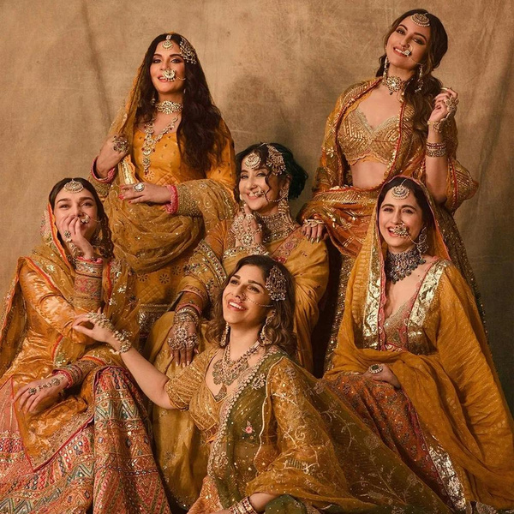
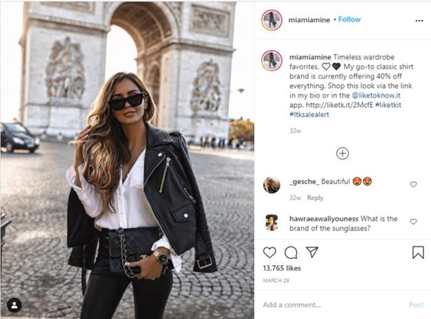
The Problem
As the influence of social media continues to grow, especially among the youth, staying updated with the latest trends has become crucial for businesses.
The fashion and lifestyle choices of young people are heavily influenced by what they see on platforms like Instagram, YouTube, Twitter, and Facebook.
Youth are increasingly driven by the latest trends they observe on social media. However, it’s challenging for businesses to keep up with these rapidly changing trends.
Traditional market research methods are often too slow to capture the fast pace of these trends, leading to missed opportunities and outdated products.

Slide 3


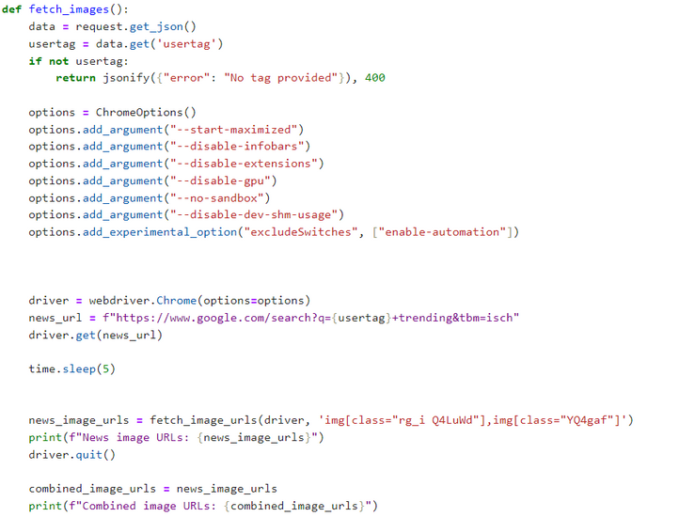


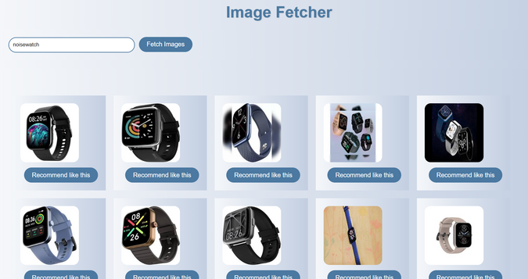
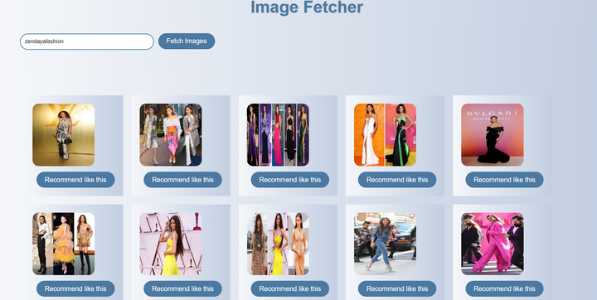
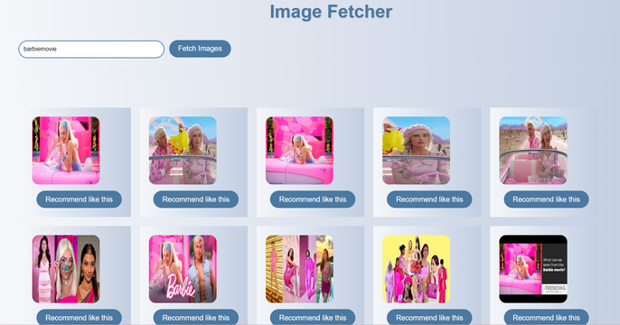
Solution
Attack No-1
Getting Trending images of the tags
Using selenium or instascrape
Tools and Technologies:
Web Drivers: Specifically, ChromeDriver for automated web browsing.
Python: For writing the scraping scripts and processing the data.
Selenium: To fetch trending hashtags from platforms like instagram,twitter,Goggle
Methodology:
Using these libraries we can extract the trending images of the particular hashtag demanded by our user, our main motive is to gather the trending images on any section whether it belongs to section “#barbie movie” or “#Baby clothes” on INSTAGRAM or X or FACEBOOK or GOGGLE or the trending tab #hashtags on X , We will look forward for everything and after getting the trending section from each query we can move forward to process images, most trending based on tags and make our dream of achievement TRUE
Personal selection query
Extracting trending
images from the hashtag given by user
Celeb centric query
Movie centric query
GATHERING TRENDING CLOTHES ✅

Slide 4
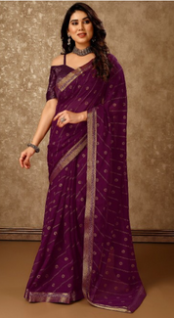
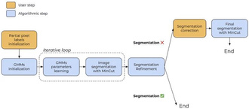
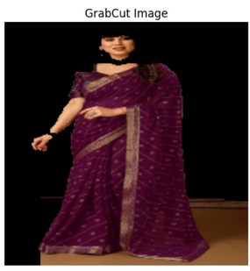
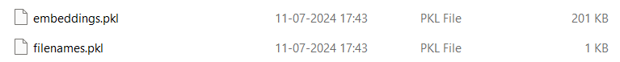
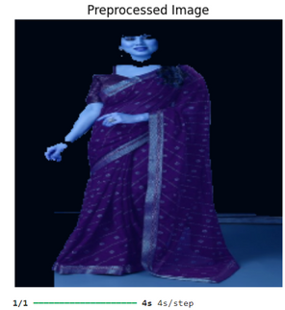
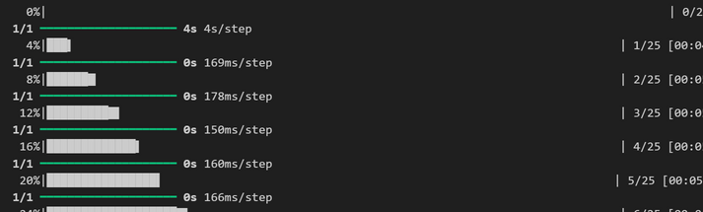
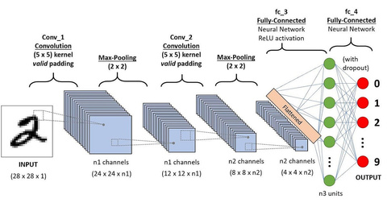
Attack No-2
Grab-cut
Solution
Tools and Technologies:
TensorFlow-For the RESnet model to work ,implementing CNN on each image of the dataset to grab its features
Python: For writing the scraping scripts and processing the data.
OpenCV - Grabcut algorithm to fetch the dresses for accurate RESNET handling
Pickle-To handle write function of the extracted features using CNN of the dataset
Methodology:
Using python libraries like OpenCV to tackle the Myntra’s dataset and perform removal of background from each of the dataset using grabcut, to fetch the only dresses , Then applying RESNET model 50 to Extract features from each of the image of the dataset.
Using RESNET
Preprocessed
Extract features from Myntra’s dataset
Saving features
CNN
Extract Features
PREPARING MYNTRA’S DATASET ✅

Slide 5

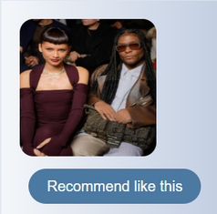
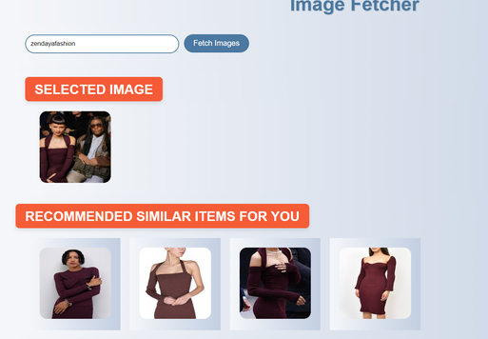
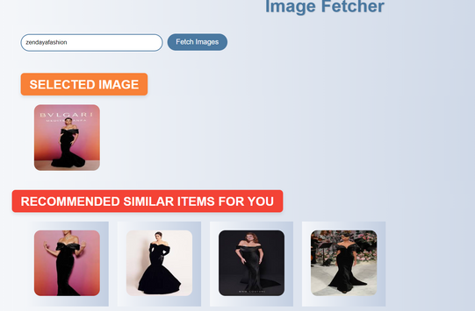
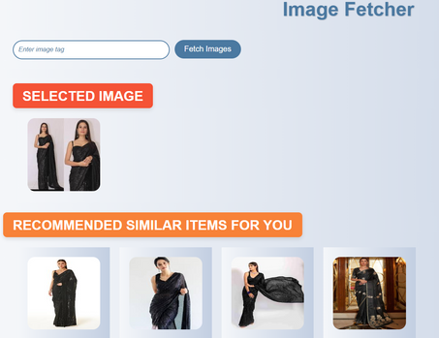
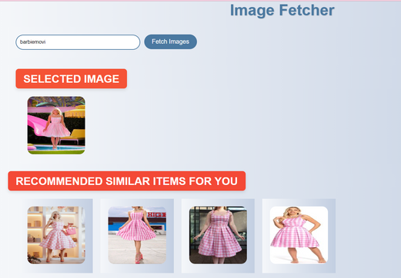
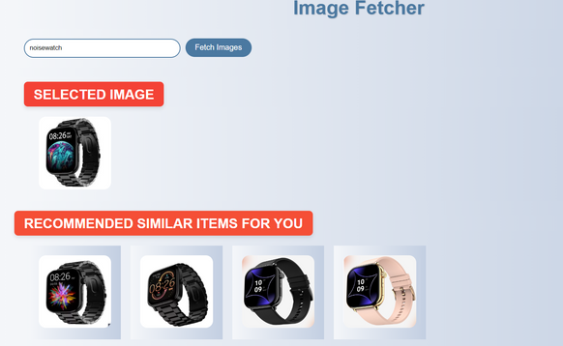

SOO MANY OPTIONS FOR A SINGLE FASHION ITEM
Solution
Attack No-3
Doesnt matter if multiple people in frame as it ultimately uses grab-cut
Tools and Technologies:
TensorFlow-For the RESnet model to work ,implementing CNN on each image of the dataset to grab its features
Python: For writing the scraping scripts and processing the data.
Pickle-To handle read function of the extracted features
Scikit-learn-Implementing Kneighbors algorithm on the dataset
Methodology:
CLICK :- RECOMMEND ME LIKE THIS
Using the ResNet module CNN on the user selected trending image and comparing it to the each image of the dataset that is already processed via Resnet , and recommending 4-5 similar vectors around it to have the exact recommendation that is liked by the user ,
Uses kneighbors algorithm (KNN) of scikit-learn, in this way we get recommend the TREND-CENTRIC demands of the user .The more query we get for the particular tag, the more we can put it in shop by trends
Coffee shouldercut bodycon
from #zendayafashion
Data
Input
CNN
KNN
Output
Frock
recommendation from
#barbiemovie
Bodycon recommendation from #zendayafashion
Black saree recommedation from #blacksaree
Popular dresses bought from #hashtags recommendation goes to Myntra
SHOP BY TRENDS
Watch
recommendation from
#noisewatch
RECOMMENDING SIMILAR CLOTHES FROM MYNTRA’S DATASET ✅

Slide 6

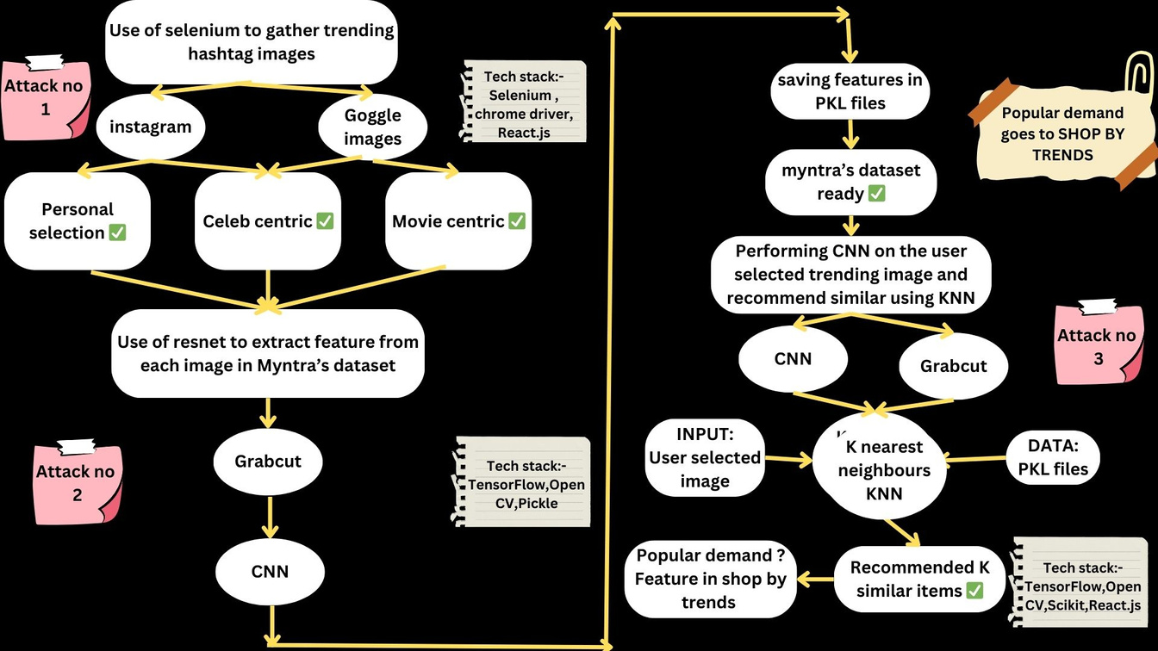
Benefits
OUR APPROACH FLOWCHART
Demo Video
Link
Tech stack
Link
Flowchart
Link
Fulfilling GENZ’S overgrowing demand of fashion
Targeting bigger section of economy as genz is more concerned towards fashion
Use of selenium will cut the cost
of using costly APIs
This approach can extract trending sections from any social media handles and is flexible , the more the data , the more better shop by trends will look

